Slide 1
The Emerging Spatial Web: The Need for “Serendipitous” Interoperability
Carl Reed, PhD
Executive Director Specification Program
November 2002
Copyright 2002, Open GIS Consortium, Inc
Notes:
In the past, GIS existed as an isolated technology, an island of automation, in the enterprise. Today, technology and market forces are changing both expectations and requirements for how geospatial technology is integrated into the IT infrastructure of the enterprise. And the pervasive force of the Internet is dictating the speed at which this change is happening. The first “web mapping” applications appeared in 1994, the Xerox ParcMap application being an excellent example. Since them the growth and ability to generate map displays on the Web has grown astronomically. It is estimated that over 50,000,000 maps a day are sent across the Internet. However, most of these maps are simple, “dump” graphics images. However, for the last several years there has been a growing need – and market pressure – to better geospatially enable the web and provide more and deeper access and capabilities for accessing and using geospatial data and services. Dumb maps are no longer enough. Discovery, analysis, modeling, dynamic visualization, change detection, and sensor webs are a few of the emerging geospatially enabled Web based applications.
This presentation considers these market forces in reference to the on-going work of the OpenGIS Consortium to define and document interface specifications that support dynamic – or serendipitous – geospatially enabled web services.
And something else to keep in mind: We all have heard how much data in the Enterprise has a spatial component. This geographic reference could be an address, a zip-code, or an explicit (x,y) coordinate. Some studies suggest that as much as 85 to 90 percent of the data in an Enterprise has a spatial component.

Slide 2
Thank you Intergraph!
OGC Member since 1994
Currently an OGC Strategic Member, the highest level of membership.
Actively involved in specification development and OGC Interoperability Initiatives
Committed to implementing OGC interfaces in product.
Copyright 2002, Open GIS Consortium, Inc

Slide 3

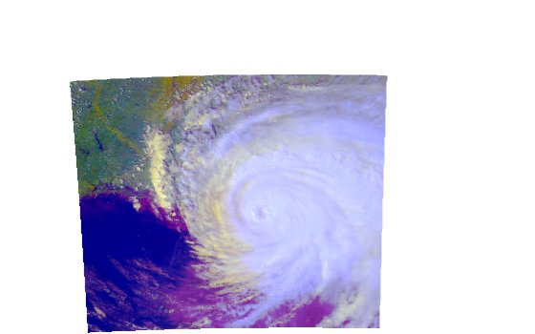
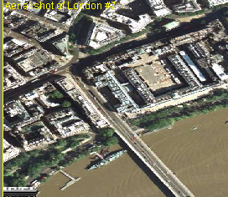

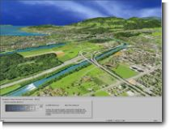

The OpenGIS® Vision
A world in which everyone benefits from geographic information and services made available across any network, application, or platform.
Copyright 2002, Open GIS Consortium, Inc

Slide 4
What is the OGC?
The Open GIS Consortium (OGC)
  Not-for-profit, international consortium
  230+ industry, government, NGO and university members
Specification Development Program -similar to other Industry consortia (W3C,ISO, etc.).
Interoperability Program (IP) - a global, innovative, hands-on engineering and testing program designed to accelerate interface development and bring interoperability to the market.
Outreach and Community Adoption Program – education and training, encourage take up of OGC interfaces, business development,
OGC Vision
A world in which everyone benefits from
geographic information and services made available
across any network, application, or platform.
OGC Mission
Our core mission is to deliver
spatial interface specifications
that are openly available for global use.
Copyright 2002, Open GIS Consortium, Inc

Slide 5



Advancing Spatial Data Infrastructure Via Interoperable Web Services
Easier access to multiple online info sources and services
Use and reuse different vendor solutions.
Reduce deployment costs by reusing information from other communities
Tools to provide custom information to users.
Foundation for interoperable service networks
Integrated View
Queries
extract info from diverse sources
Whoville
Cedar Lake
Buildings
Roads
Images
Targets
Boundaries
...
Whoville
Cedar Lake
Catalog
View
Internet
Common interfaces enable interoperability
Gazetteer
Coordinate
Transform
Web Mapping Server, Web Feature Server, Web Coverage Server
Catalog Services
Geoparser
Clearinghouse
Geoparser
Geoparser
Other
Services
Vendor
Data
Local
Government
National
Government
Other
Collections
Clearinghouse
Clearinghouse
Geocoder
Metadata
Data
Metadata
Data
Metadata
Data
Metadata
Copyright 2002, Open GIS Consortium, Inc

Slide 6
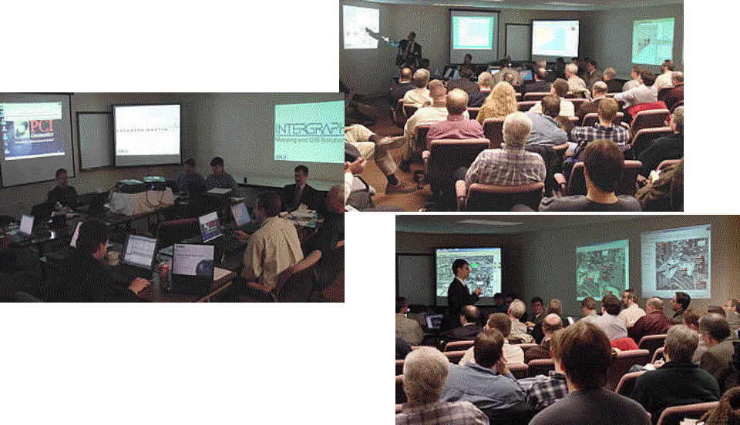
A breakthrough – A New Interface Development and Specifications Process
Initially..
OGC and its membership applied a traditional approach for development of standardized interface specifications.
Today..
Rapid industry prototyping is accelerating specification development and implementation of open systems to meet user requirements
Prototypes result in:
  candidate specifications
  product implementations
  demonstrated capability
Copyright 2002, Open GIS Consortium, Inc

Slide 7
The OGC vision requires a kind of global geospatial and IT community
Composed of many collaborating organizations... authoring and publishing geospatial information
Copyright 2002, Open GIS Consortium, Inc

Slide 8
A SPATIAL WEB!
Copyright 2002, Open GIS Consortium, Inc

Slide 9
A community of sharing…
Methods
Science
Technology
Applications
Understanding
Data
Management
Service
Copyright 2002, Open GIS Consortium, Inc

Slide 10
Is this vision of a spatial web practical?
. . . Yes
. . . It’s inevitable
Like the Internet it will evolve
and encompass many communities
Copyright 2002, Open GIS Consortium, Inc

Slide 11
A global “spatial web” or community requires…
Creating standardized data models and data sets
Network of data and service providers (collaborators)
Policy framework for dissemination
Leadership / organization
Technology and packaging for easy deployment
Educated professionals
Copyright 2002, Open GIS Consortium, Inc

Slide 12
What is Geospatial Interoperability
“Geographic interoperability” is the ability of information systems to freely exchange all kinds of spatial information and cooperatively, over networks, run software capable of manipulating such information AND the user requires no knowledge of the underlying infrastructure. (From OGC AS Topic 12 and ISO 19119 – Geographic Services)
Copyright 2002, Open GIS Consortium, Inc

Slide 13
Standards, Specifications, and Interoperability
Standards bind the technology we use together into predictable patterns.
When they work, you may not notice them.
Development of technology drives the need for standards and interoperability. For example:
  “Standard Time” came from the railroad industry.
  The Internet is built on Standards (TCP/IP).
  World Wide Web Standards (HTTP/XML).
Interoperability means systems work together.
Client1
Client2
Client3
Server1
Server2
Server3
Figure 1: “Stove Pipe” Systems
Client1
Client2
Server1
Server2
Server3
Figure 2: Interoperable Systems
Copyright 2002, Open GIS Consortium, Inc
Notes:
Open standards-based architectures allow systems to talk to each other. This approach has emerged as a key to integrating distributed information sources (eliminating “stove-pipe” systems).
Standards-based, component architectures allows distributed systems to be built so that components plug together seamlessly. This also means that the distributed systems can be easily upgraded and expanded.
Figure 1 shows three client/server “stove pipes," where the user must run three different client applications in order to access the data and functionality provided by three different server implementations. In this situation, there is very little interoperability or reuse of client and server implementations. Because data are often accessible only through a given server, there is very limited ability for a user to transparently access data of interest from outside a fixed client/server stack.
Figure 2 shows several client/server systems that are interoperable. This means that there can be reuse of client and server implementations. In this case, we have at our disposal a variable and potentially large set of servers from multiple vendors and organizations.

Slide 14
So what does the OGC as an entity Provide
An agreed upon consensus process for defining, testing, documenting, and approving interface specifications
Staff to work with the members to facilitate the consensus process the culminates in approved and adopted specifications.
Staff knowledge and expertise.
A framework.
Communications infrastructure.
Copyright 2002, Open GIS Consortium, Inc

Slide 15
Example Members
Integrators
  Raytheon, Lockheed Martin, Mitsubishi, SAIC, Harris, MITRE, BAE, …
Major Hardware and Software Companies
  Sun Microsystems, Oracle, Microsoft, Adobe, HP, SAS, …
Developers of GeoSpatial Technology products
  Intergraph, ESRI, SICAD, AutoDesk, LaserScan, MapInfo, SmallWorld, PCI
Government agencies that depend on geoprocessing
  NIMA, NASA, USGS, USA/TEC, USDA, NOAA, FEMA, DoT, Census, NSF, FGDC, , DMSO, UK/OS, Au/SA, …
Location Services/Telecoms
  Hutchison 3G, Webraska, SignalSoft
Others
  Content Providers, Power, Universities, Consultants, Startups, …
Copyright 2002, Open GIS Consortium, Inc

Slide 16

OGC Roadmap and
Baseline
Broad scale application of geoprocessing technology and expanded understanding of global inter-community relationships
Development of second generation semantic-based information interoperability and decision support systems?
Improved integration of geoprocessing with mainstream information technology capabilities?
Development of information and multi-platform interoperability capacity?
Improved inter-community and multi-enterprise data and processing resource sharing and platform-independent interoperability?
Development of first generation of web-based interoperable services
Capacity to exchange geospatial information and services across multiple computing environments, integrated with mainstream information technology
Technical and Socioeconomic Impact
Improved multi-source information operations for technical interoperability in web-based environments, enabled enterprise applications and location services,
broad base of operational implementations
Development of Open GIS Abstract Models
Enhanced understanding of geoprocessing interoperability and digital representation of the Earth and Earth phenomena
Current Strategic Focus is:
Steady improvement in the Technical Baseline and inter-community resource sharing capacity
Open GIS Consortium established and Technical Committee organized
OGC Technical Baseline
1994 1996 1998 2002 2004 2006 2008
Copyright 2002, Open GIS Consortium, Inc

Slide 17
Web Services are Important to the OGC and our membership
Copyright 2002, Open GIS Consortium, Inc

Slide 18
Currently
50 million+ map images a day are transmitted on the Internet
85 to 90% of all enterprise data have a location element.
Application complexity: From simple map images to routing, driving directions, change detection, dynamic discovery, and dynamic visualization.
More and more web sites, portals, and web map applications are making use of geospatial data.
Web mapping applications have been “stovepipe” implementations, but that is changing quickly.
Copyright 2002, Open GIS Consortium, Inc

Slide 19
So . . .
All the trends indicate that we are facing the emergence of a Geospatially Enabled Web of data and services in which a virtual global geodata repository will be available anytime, anywhere, to anyone.
Copyright 2002, Open GIS Consortium, Inc

Slide 20
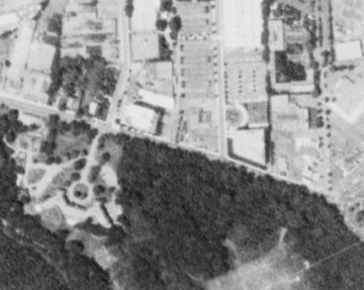
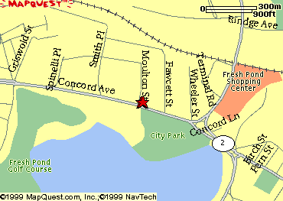
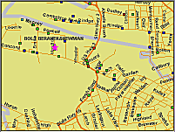
Before Interoperability and the 1999 OGC Web Mapping Test Bed
Copyright 2002, Open GIS Consortium, Inc

Slide 21
WMS Demonstration:
NOAA Satellite Image from one Server
Copyright 2002, Open GIS Consortium, Inc

Slide 22
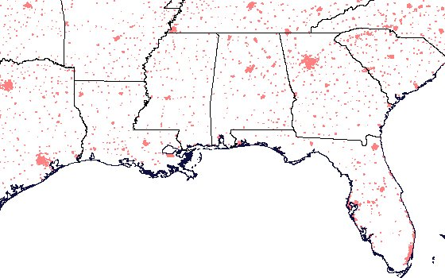
And vector data from three different servers
Copyright 2002, Open GIS Consortium, Inc

Slide 23
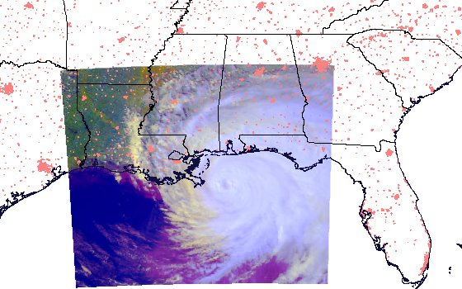
Merged Image at the Client
Copyright 2002, Open GIS Consortium, Inc

Slide 24
This proved that geospatial interoperability is real!
Copyright 2002, Open GIS Consortium, Inc

Slide 25

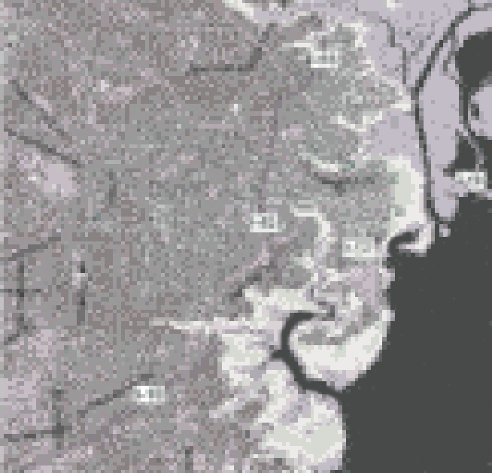
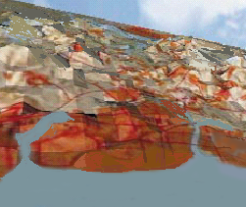
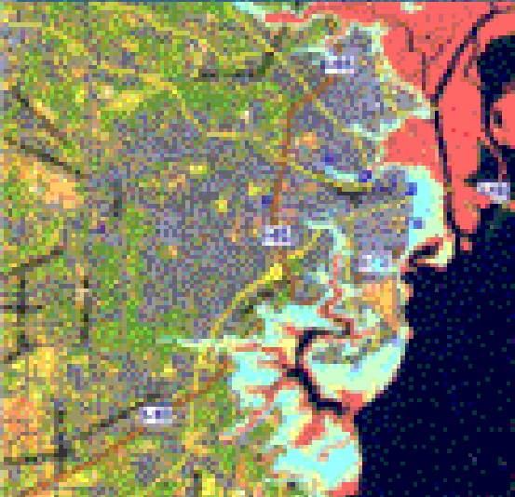


Web Feature
Server
Web Coverage
Server
Web Map
Server
Web
Terrain
Server
Copyright 2002, Open GIS Consortium, Inc

Slide 26
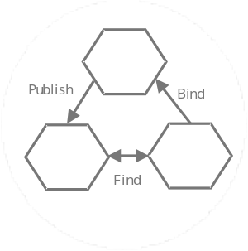
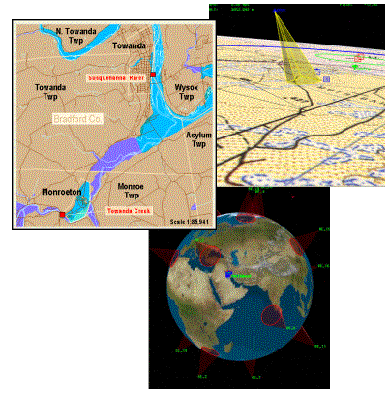
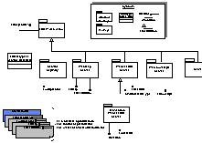
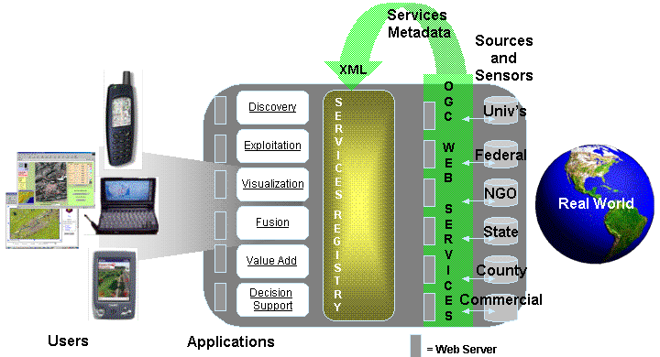
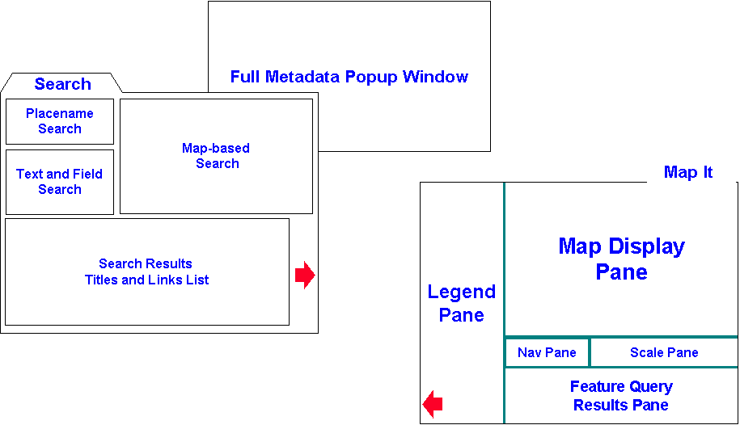
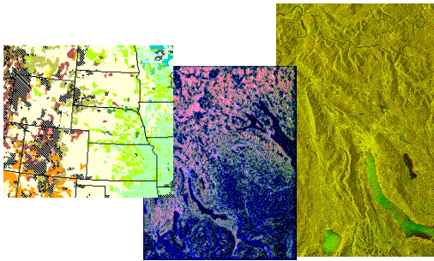
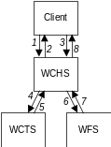
OWS 1.1 Focus Areas (2001)
Sensor Web Enablement
Common
Architecture
Web Mapping
Client Applications
Web-Based
Exploitation
Geoanalysis &
Decision Support
Copyright 2002, Open GIS Consortium, Inc

Slide 27
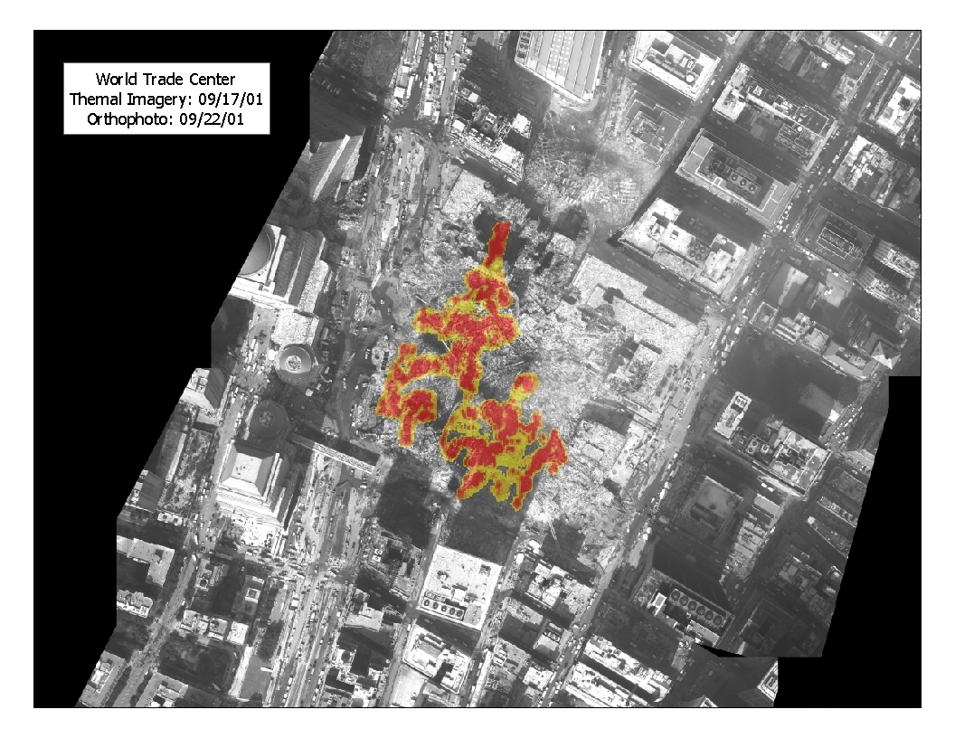
OGC Web Services Demonstration
New York City
17 Participating organizations (vendors, NYC, Universities, and Federal Agencies)
Integration with real time sensor webs.
Satellite imagery, orthophotos and planimetric data.
Multiple clients interfacing to over a dozen data repositories.
Vendor Neutral
Copyright 2002, Open GIS Consortium, Inc

Slide 28
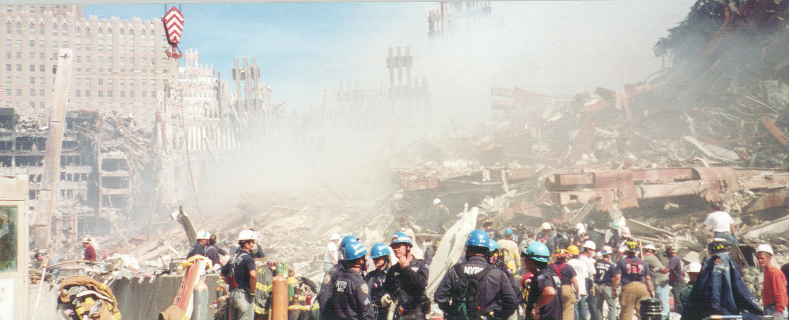
OWS Demo: Sensor Web Access
Emergency modeling and analysis
Air and water quality specialist uses meteorological SCS to drive aerial plume dispersion model.
Specialist views measurements from air and water quality sensors.
SCS
SAIC
NOAA
METAR Data
NY State
Air Quality Data
Map Viewer
SAIC
SCS
Polexis
SCS
SAIC
YSI Water Quality
Meteorology Sensor
WMS
CubeWerx
NYC
OrthoImagery
Copyright 2002, Open GIS Consortium, Inc

Slide 29
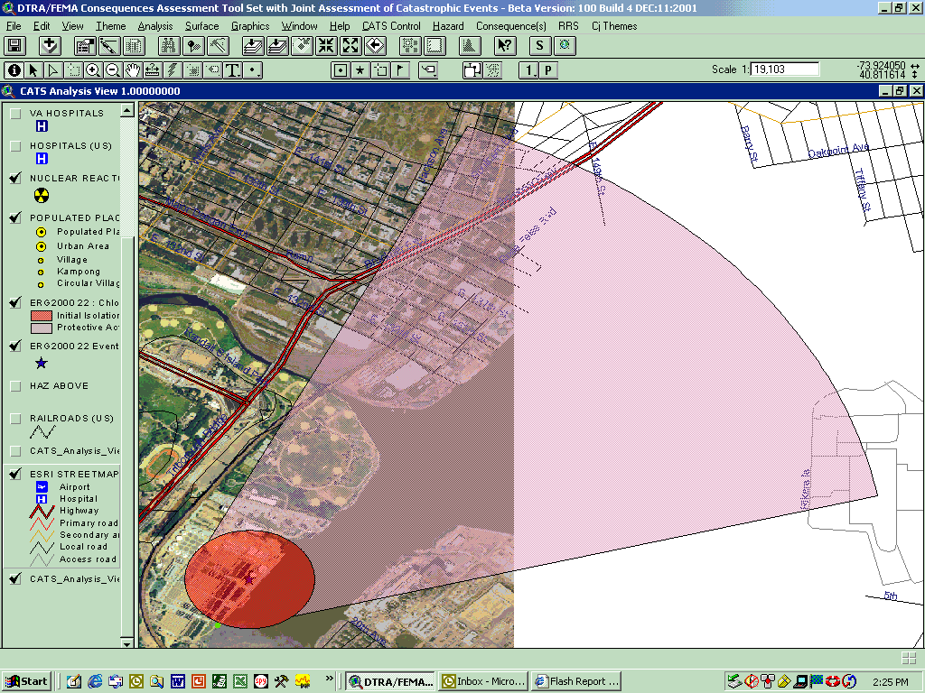
Creating a presentation such as . . .
Copyright 2002, Open GIS Consortium, Inc

Slide 30
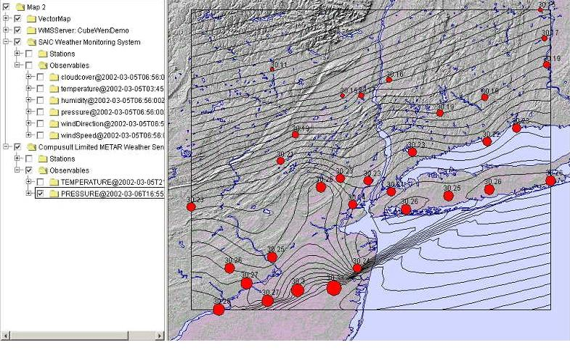
Or . . .
Copyright 2002, Open GIS Consortium, Inc

Slide 31
OGC Web Services 1.2 Underway
Primary Goal: extend engineering interface specifications developed in OWS Thread Set 1 and other initiatives including: OGC Common Architecture, Web Mapping, Imagery Exploitation and Sensor Web specifications.
Copyright 2002, Open GIS Consortium, Inc

Slide 32
OGC Web Services 1.2 Technical Overview
Sensor Web capabilities
Vector Data Feature production
Imagery production
Common Architecture Enhancements
In all cases, need to deal with registries (data, services etc), catalogs, multi-source, multi-vendor.
Copyright 2002, Open GIS Consortium, Inc

Slide 33
OWS 1.2 Focus Areas (2002)
Sensor Web Enablement
Common
Architecture
Web Mapping
Client Applications
Web-Based
Exploitation
Geoanalysis &
Decision Support
Copyright 2002, Open GIS Consortium, Inc

Slide 34
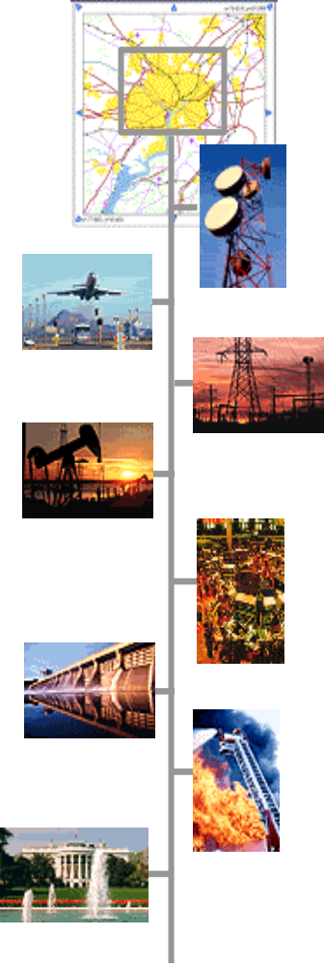
OGC Critical Infrastructure Protection Initiative
Timely, accurate information, easily accessed and capable of being shared across federal, state, and local political jurisdictions is fundamental to the decision making capability of those tasked with the homeland security mission. (FGDC Report on Homeland Security and GIS)
  Interoperability is Critical!
Telecommunications
Transportation
Electric Power
Oil and Gas
Banking and Finance
Water
Emergency Services
Continuity of Govt
Copyright 2002, Open GIS Consortium, Inc

Slide 35
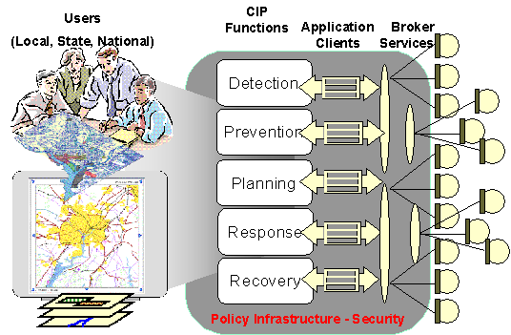
OGC Critical Infrastructure Protection Initiative (CIPI)
OGC Interoperability Initiative designed to develop, test, and validate interoperable technology and architectures to meet Information Sharing challenges
Coordination with National, State, Local Government, Commercial, and Non-Government Organizations.
Enable growth of a collaborative, distributed network of critical infrastructure information sources and services based open standards (OGC Web Services).
Copyright 2002, Open GIS Consortium, Inc

Slide 36
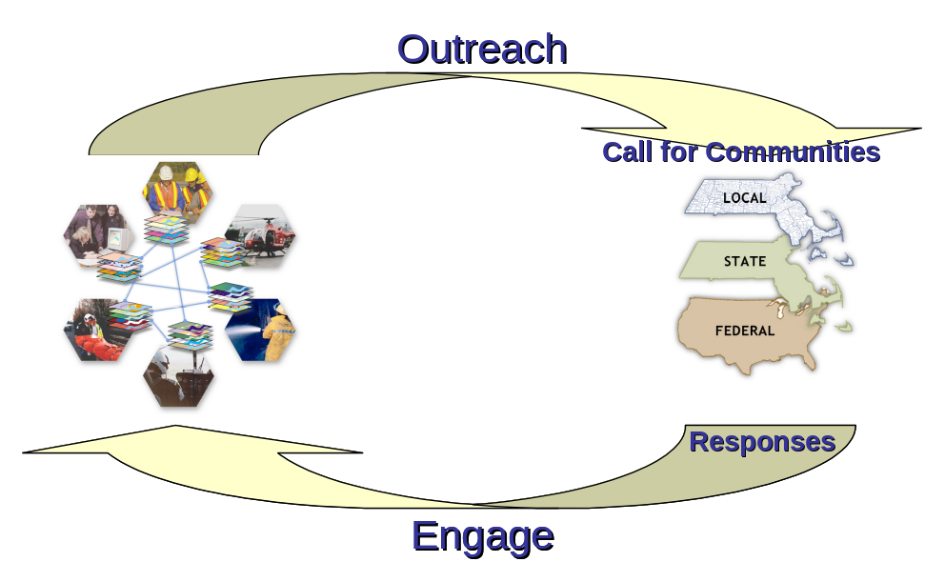
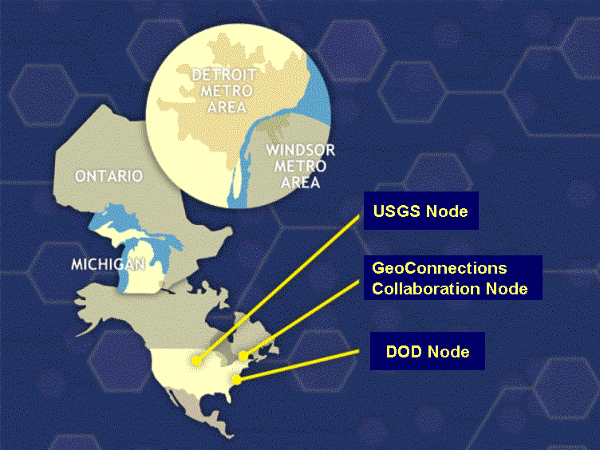
Community Involvement Essential –
CIPI Call for Communities (CFC) and CIPI-1
Industry, State, Provincial, and Local governments, nongovernmental organizations, Universities at multiple levels, other industry groups
Community Meeting on September 24, 2002 – Outstanding Participation!
Focus of CIPI-1 will be a Cross Border Pilot Project with Transportation Theme
Copyright 2002, Open GIS Consortium, Inc

Slide 37
Community Meeting – Sept 24, 2002
Wayne State University (our host)
City of Windsor
City of Detroit
Detroit Public Schools
State of Michigan IGRE
Detroit Police Department
Michigan State Police
Eastern Michigan University
Ontario Ministry of Natural Resources, GeoConnections
OCIPEP
OGC IPTeam
and many others
Copyright 2002, Open GIS Consortium, Inc

Slide 38
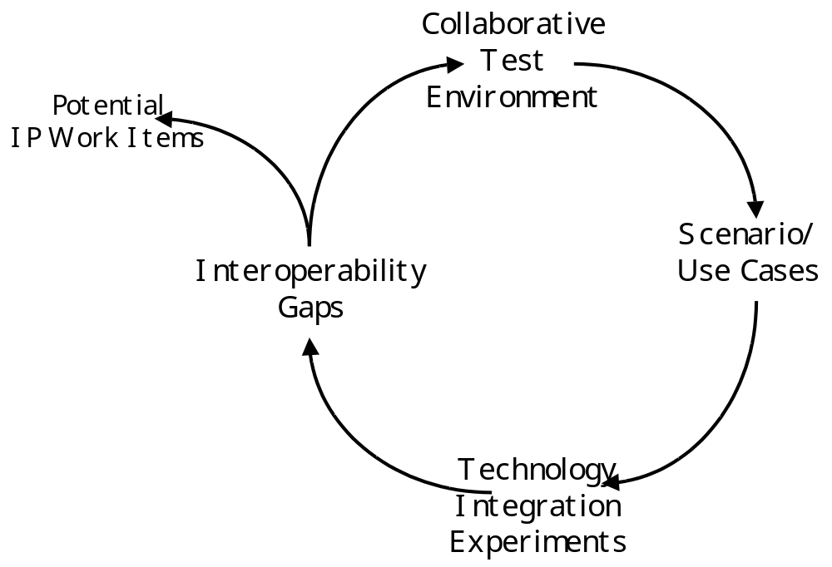
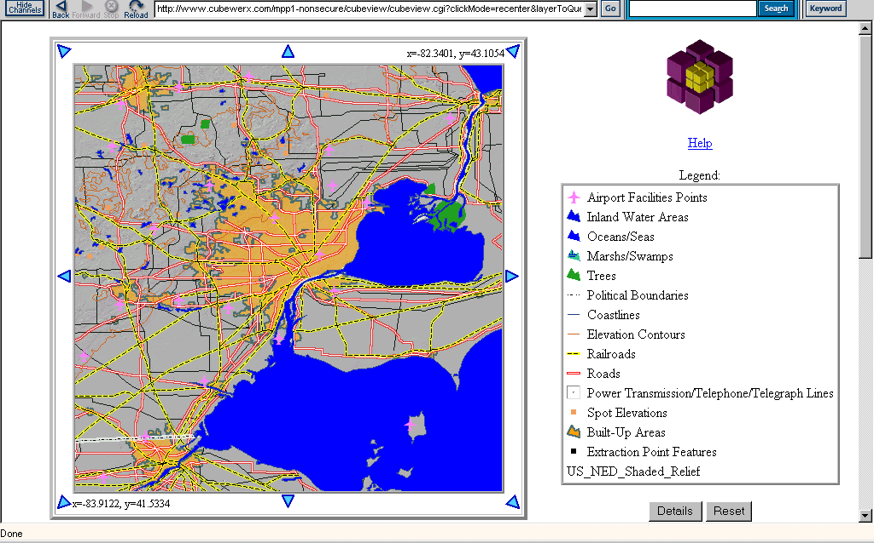
CIPI-1 Scenario-based Development
Conduct incremental scenario-based testing.
Identify an initial set of standards gaps OGC’s approved and emerging OpenGIS® Specifications that should be filled to achieve assurance of service and data accessibility, utility and usability for Critical Infrastructure Protection.
Assess policy and organizational interactions required to support cross-organizational interoperability
Copyright 2002, Open GIS Consortium, Inc

Slide 39
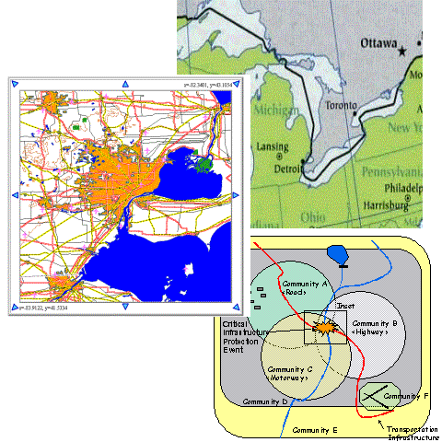
Proposed CIPI-1 Scenario
Cross-Border “Transportation”
Infrastructure
SCENARIO DESCRIPTION:
A truck carrying an unknown hazardous chemical is hijacked in the area of Detroit Michigan. The truck is moving.
The trucks original final destination was to be a chemical plant in the U.S.
The hijackers inform the media that they intend to take the truck to one of the major border crossings in the area and will detonate the truck releasing the hazardous chemical.
Inspection stations at the Ambassador Bridge between Detroit and Windsor, Ontario, Canada--the busiest border crossing in North America, handling 7,000 trucks each day
Copyright 2002, Open GIS Consortium, Inc

Slide 40


OGC Web Services for the
Mobile Domain: Location Services Test bed
  Navigation Service (Routing)
  Proximity Service
  Yellow/White Pages
  Web Map Server (Existing)
  Vector Map Portrayal Service
  Geocoding Service (Existing)
  Get Device Location (Use LIF)
  GML 2.1 extended for LS
Copyright 2002, Open GIS Consortium, Inc

Slide 41
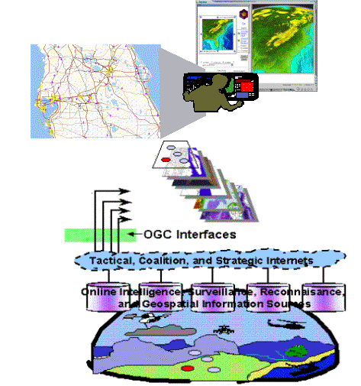
And coordination with other standards/specifications organizations
ISO TC 211
LIF
IETF
W3C
Copyright 2002, Open GIS Consortium, Inc

Slide 42
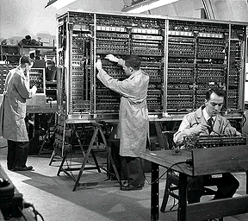
Let’s not forget how far we have come!
Copyright 2002, Open GIS Consortium, Inc

Slide 43
The Importance of Interoperability
A standards-based framework is essential to develop a federated network of critical infrastructure information sources.
Required for cross-vendor, cross platform information sharing in a distributed environment.
Critical to the success of Information and Application Integration as envisioned in all industry segments.
Required for true collaborative communities.
Required to leverage the true value of our geographically based information resource.
Data neutral and vendor neutral
Copyright 2002, Open GIS Consortium, Inc

Slide 44
Thank you for your attention and enjoy the rest of the conference!
Dr. Carl Reed can be contacted at:
creed@opengis.org
Visit us at:
www.opengis.org
Copyright 2002, Open GIS Consortium, Inc

